Slide 1
Retrieval-Augmented Generation for Code Summarization via Hybrid GNN
ICLR 2021 under review
Rating: 7 7 7

Slide 2
Introduction
Key challenges in source code summarization:
Source code and natural language summary are heterogeneous.
Source code is complex, making it hard to learn the semantics.
Retrieval-based approaches are limited in generalization.
They have poorer performance on programs that are very different from the code database.

Slide 3
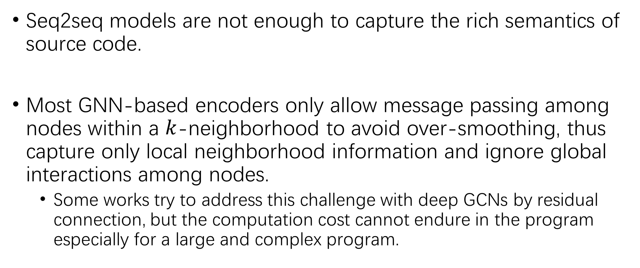
Introduction
Seq2seq models are not enough to capture the rich semantics of source code.
Most GNN-based encoders only allow message passing among nodes within a $k$-neighborhood to avoid over-smoothing, thus capture only local neighborhood information and ignore global interactions among nodes.
Some works try to address this challenge with deep GCNs by residual connection, but the computation cost cannot endure in the program especially for a large and complex program.

Slide 4
Our model
We propose a framework called Hybrid-GNN (HGNN).
First construct a code property graph (CPG) based on AST with different types of edges.
Use the retrieved code as well as the corresponding summary as auxiliary information for training the model.
Construct an attention-based dynamic graph by learning global attention scores (i.e. edge weights) in the augmented static CPG.
Perform a hybrid message passing (HMP) on both static and dynamic graphs.

Slide 5
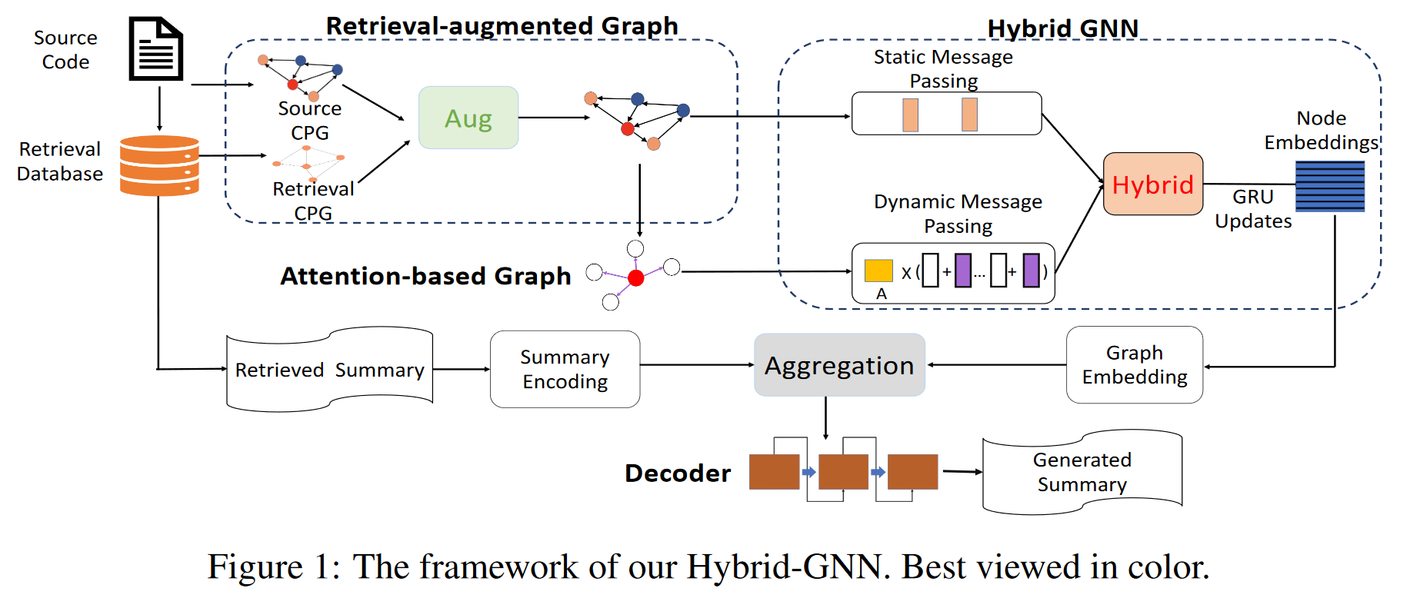
Hybrid-GNN Framework

Slide 6
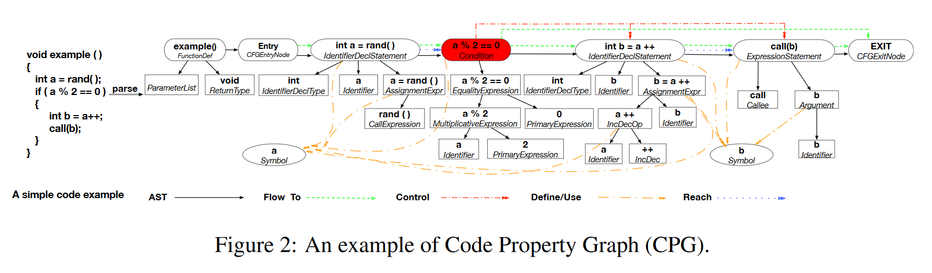

Retrieval-Augmented Static Graph
$$D=\left\{\left(c, s\right)|c∈C, s∈S\right\}.$$
$$c⇒g\left(𝒱, ℰ\right).$$
This is the construction of the Code Property Graph. Refer to (Yamaguchi et al., 2014) for more detail about CPG.

Slide 7
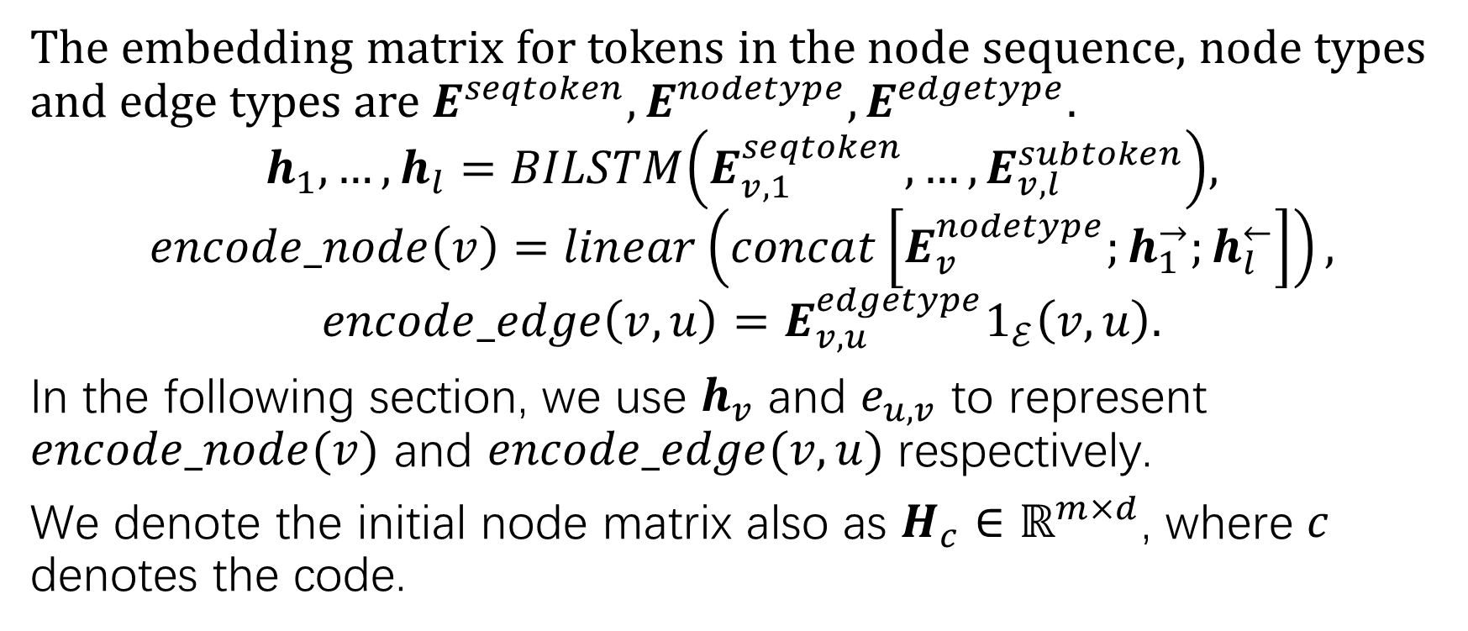
Retrieval-Augmented Static Graph Initialization
The embedding matrix for tokens in the node sequence, node types and edge types are $E^{seqtoken}, E^{nodetype},E^{edgetype}.$
$$h_{1},…,h_{l}=BILSTM\left(E_{v, 1}^{seqtoken},…,E_{v, l}^{subtoken}\right),$$
$$encode_node\left(v\right)=linear\left(concat\left[E_{v}^{nodetype};h_{1}^{→};h_{l}^{←}\right]\right),$$
$$encode_edge\left(v, u\right)=E_{v,u}^{edgetype}1_{ℰ}\left(v, u\right).$$
In the following section, we use $h_{v}$ and $e_{u,v}$ to represent $encode_node(v)$ and $encode_edge(v,u)$ respectively.
We denote the initial node matrix also as $H_{c}∈ℝ^{m×d}$, where $c$ denotes the code.

Slide 8
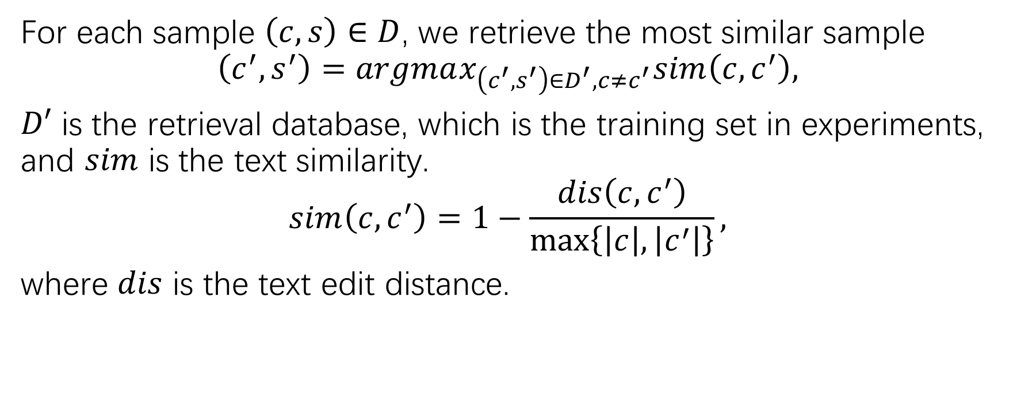
Retrieval-Based Augmentation
For each sample $\left(c, s\right)∈D$, we retrieve the most similar sample
$$\left(c^{′}, s^{′}\right)=argmax_{\left(c^{′},s^{′}\right)∈D^{′},c≠c^{′}}sim\left(c,c^{′}\right),$$
$D′$ is the retrieval database, which is the training set in experiments, and $sim$ is the text similarity.
$$sim\left(c, c^{′}\right)=1−\frac{dis\left(c,c^{′}\right)}{\max\left\{\left|c\right|, \left|c^{′}\right|\right\}},$$
where $dis$ is the text edit distance.

Slide 9
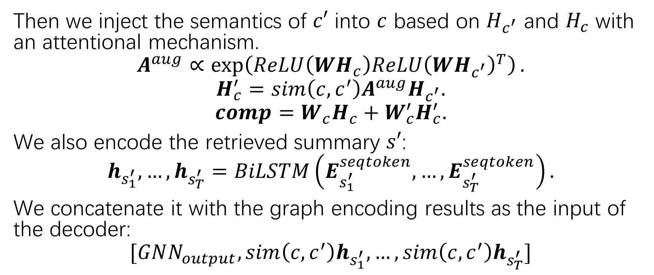
Retrieval-Based Augmentation
Then we inject the semantics of $c′$ into $c$ based on $H_{c^{′}}$ and $H_{c}$ with an attentional mechanism.
$$A^{aug}∝\exp\left(ReLU\left(WH_{c}\right)ReLU{\left(WH_{c^{′}}\right)}^{T}\right).$$
$$H_{c}^{′}=sim\left(c,c^{′}\right)A^{aug}H_{c^{′}}.$$
$$comp=W_{c}H_{c}+W_{c}^{′}H_{c}^{′}.$$
We also encode the retrieved summary $s′$:
$$h_{s_{1}^{′}},…,h_{s_{T}^{′}}=BiLSTM\left(E_{s_{1}^{′}}^{seqtoken},…,E_{s_{T}^{′}}^{seqtoken}\right).$$
We concatenate it with the graph encoding results as the input of the decoder:
$$[GNN_{output},sim\left(c,c^{′}\right)h_{s_{1}^{′}},…,sim\left(c,c^{′}\right)h_{s_{T}^{′}}]$$

Slide 10
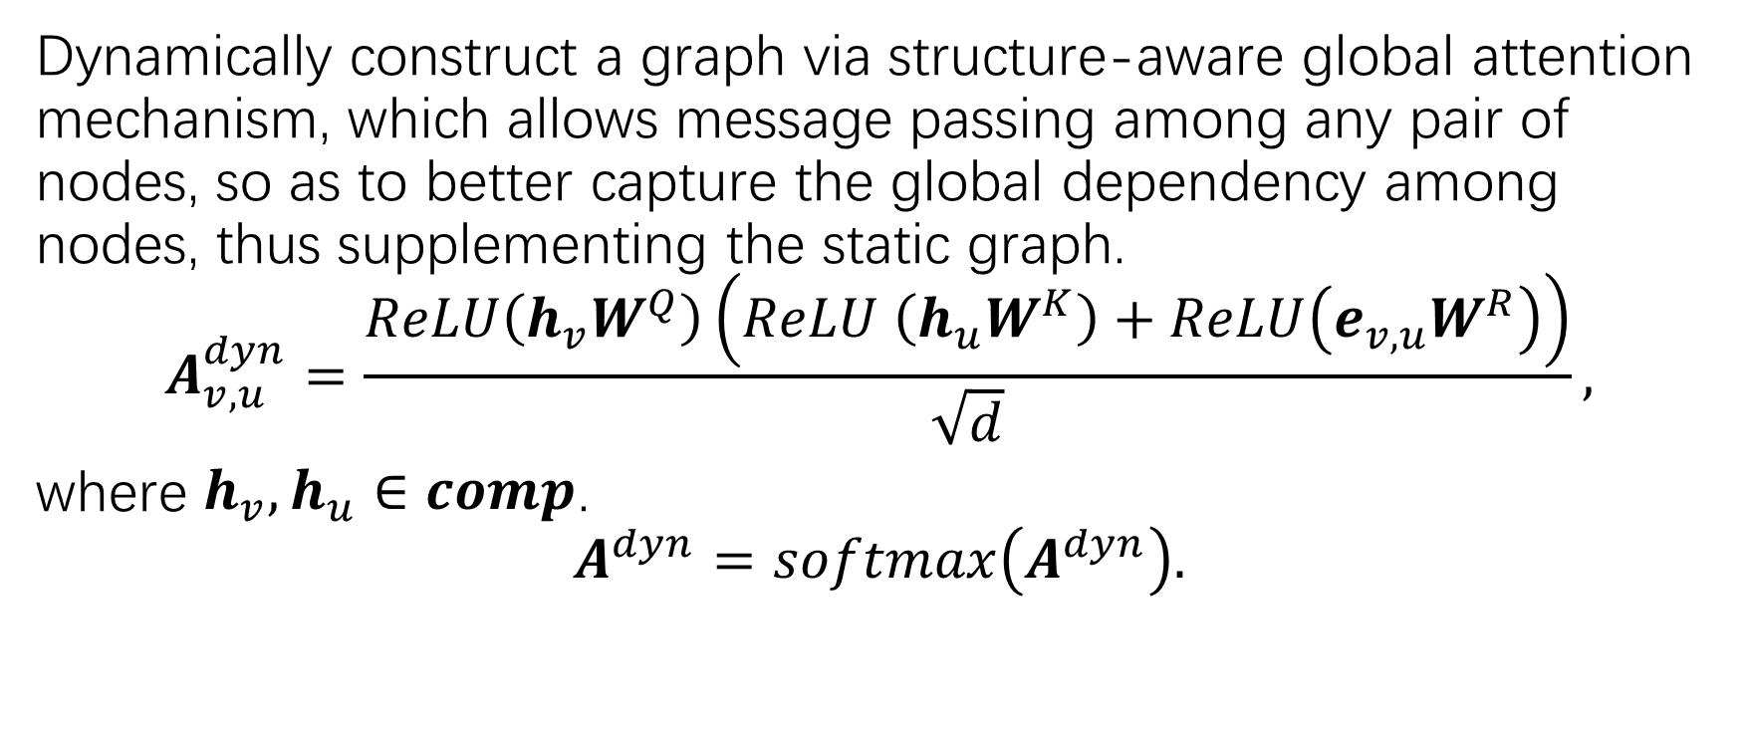
Attention-based Dynamic Graph
Dynamically construct a graph via structure-aware global attention mechanism, which allows message passing among any pair of nodes, so as to better capture the global dependency among nodes, thus supplementing the static graph.
$$A_{v,u}^{dyn}=\frac{ReLU\left(h_{v}W^{Q}\right)\left(ReLU \left(h_{u}W^{K}\right)+ReLU\left(e_{v,u}W^{R}\right)\right)}{\sqrt{d}},$$
where $h_{v},h_{u}∈comp$.
$$A^{dyn}=softmax\left(A^{dyn}\right).$$

Slide 11
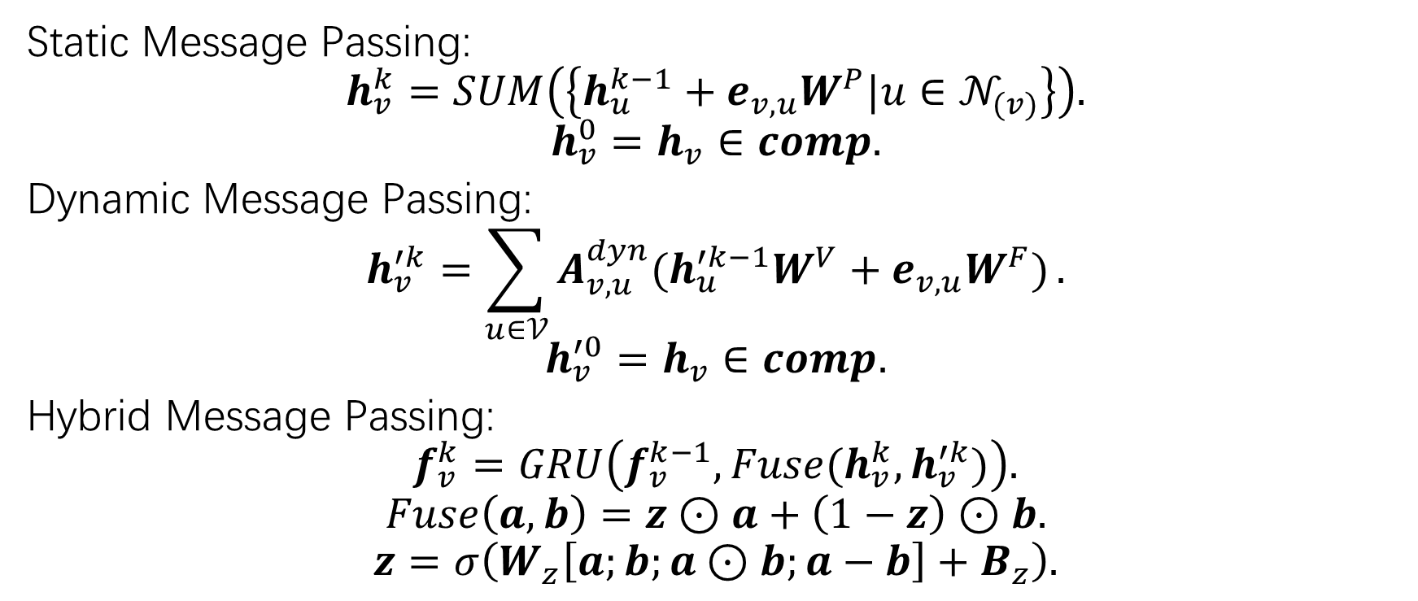
Hybrid GNN
Static Message Passing:
$$h_{v}^{k}=SUM\left(\left\{h_{u}^{k−1}+e_{v,u}W^{P}|u∈𝒩_{(v)}\right\}\right).$$
$$h_{v}^{0}=h_{v}∈comp.$$
Dynamic Message Passing:
$$h_{v}^{′k}=\sum_{u∈𝒱}{A_{v,u}^{dyn}(h_{u}^{′k−1}W^{V}+e_{v,u}W^{F})}.$$
$$h_{v}^{′0}=h_{v}∈comp.$$
Hybrid Message Passing:
$$f_{v}^{k}=GRU\left(f_{v}^{k−1},Fuse(h_{v}^{k},h_{v}^{′k})\right).$$
$$Fuse\left(a,b\right)=z⊙a+\left(1−z\right)⊙b.$$
$$z=σ\left(W_{z}\left[a;b;a⊙b;a−b\right]+B_{z}\right).$$

Slide 12
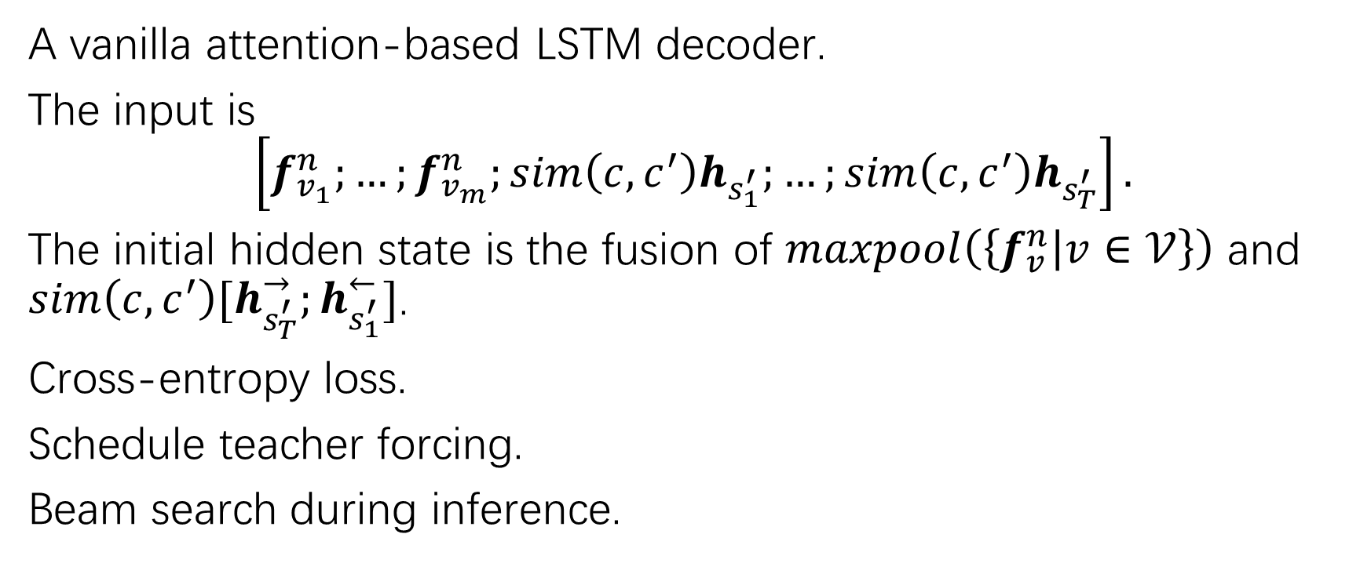
Decoder
A vanilla attention-based LSTM decoder.
The input is
$$\left[f_{v_{1}}^{n};…;f_{v_{m}}^{n};sim\left(c,c^{′}\right)h_{s_{1}^{′}};…;sim\left(c,c^{′}\right)h_{s_{T}^{′}}\right].$$
The initial hidden state is the fusion of $maxpool\left(\left\{f_{v}^{n} | v∈𝒱\right\}\right)$ and $sim\left(c,c^{′}\right)[h_{s_{T}^{′}}^{→};h_{s_{1}^{′}}^{←}]$.
Cross-entropy loss.
Schedule teacher forcing.
Beam search during inference.

Slide 13
Baselines
Retrieval-based:
TF-IDF
NNGen
Sequence-based:
CODE-NN
Rencos (combines the retrieval information)
Dual model
Graph-based:
SeqGNN
GCN2Seq (GCN as encoder, LSTM as decoder)
GAT2Seq (GAT as encoder, LSTM as decoder)

Slide 14
Dataset
A self-made neural summarization dataset on C programming language at function level, namely, C Code Summarization Dataset (CCSD).
Data come from popular C repositories on GitHub and extract function-summary pairs based on the documents of functions.
95k+ unique pairs after a strict deduplication process.
The dataset contains in-domain functions and out-of-domain functions.
In some projects, some functions are randomly selected as the training data, and the else are the in-domain valid/test data.
In the other projects, all functions are used as out-of-domain test data.
Train in-domain valid in-domain test out-of-domain test 82656 4340 4124 2264

Slide 15
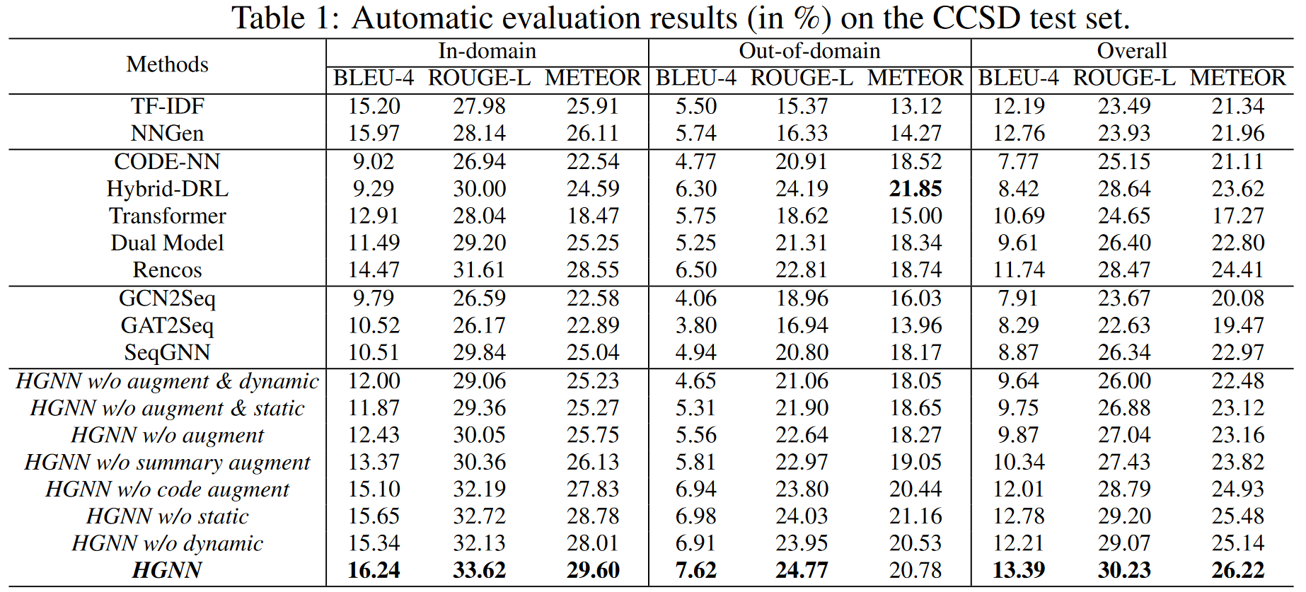
Comparison with the Baselines and Ablation Study
Notes:
Retrieval-based在BLEU-4上很好，但在ROUGE-L和METEOR上不好；在out-of-domain时也不好。
Graph-based连HGNN w/o augment都打不过，说明HGNN对全局信息的额外捕捉有用。
Ablation study:
去掉augment，性能降得厉害，特别是in-domain部分。
只去code augment或summary augment一个，降得没那么厉害，说明有效。
Summary augment导致下降更多，猜测是任务相关：任务就是生成summary，且code和summary本来也是异质的，因此summary augment本就提供更直接的信号。
去掉static和dynamic都导致性能下降，去掉dynamic更差一点，说明dynamic捕捉的信息有用。
先去掉augment再去掉static/dynamic也印证了这点。

Slide 16
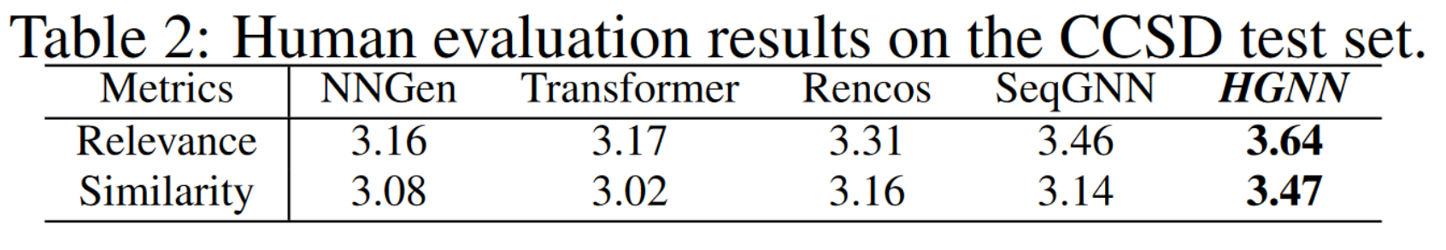
Human Evaluation
5 Ph.D. students and 10 master students as volunteers.
50 functions per approach.
Metrics (1 to 5, the higher the better):
Relevance of generated summary to source code.
Degree of similarity between generated summary and actual summary.

Slide 17
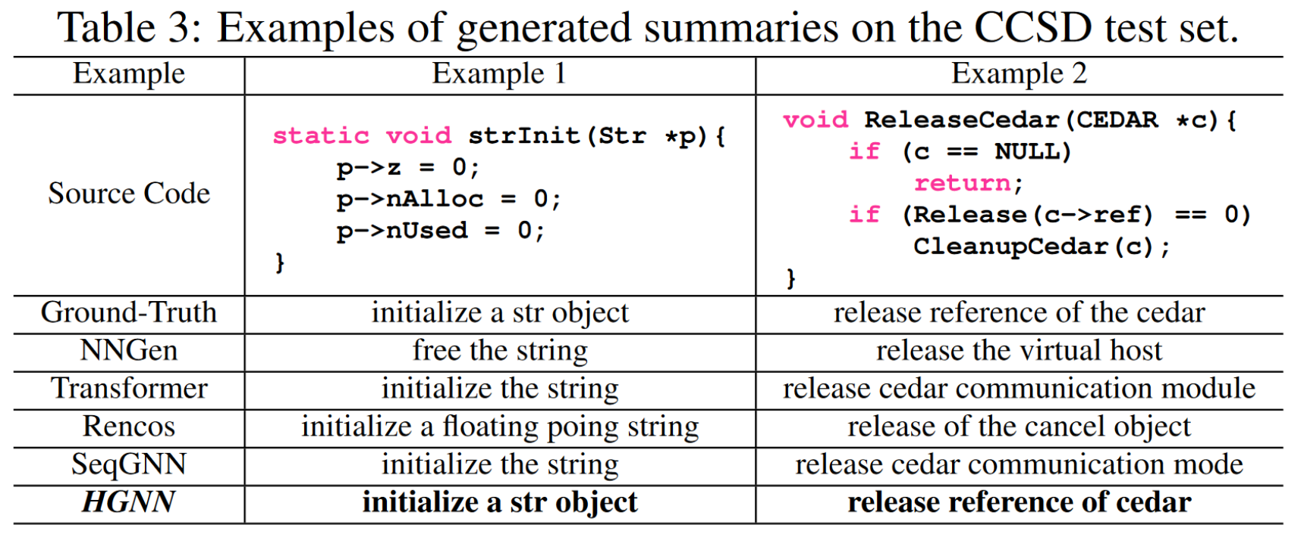
Case Study

Slide 18
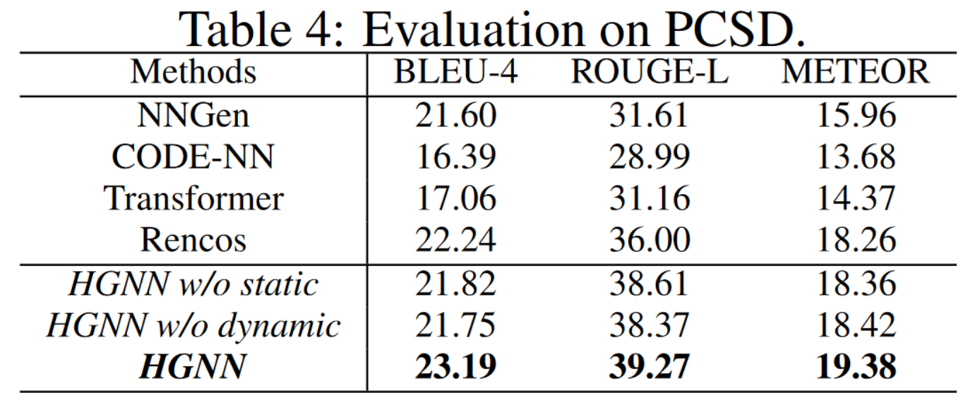
Results on Public Dataset
Additional experiments on the Python Code Summarization Dataset (PCSD), whose size is 109.7k, split into training set, validation set and testing set with fractions of 60%, 20% and 20%.

Slide 19
Conclusion and Future Work
A novel retrieval-augmented mechanism for combing the benefits of both retrieval-based and generation-based approaches.
A hybrid message passing GNN based on both static and dynamic graphs.
Explore more effective ways to learn graph structures,
Combine other information, e.g. API knowledge.

